Slide 1
Applied Statistical Analysis
EDUC 6050
Week 3
Finding clarity using data

Slide 2
Today
Review Statistical Terminology
Central Tendency
Variability
Confidence Interval

Slide 3
Reliability and Validity
Reliability: the consistency of the measure
Validity: does it measure what we think it measures?
Notes:
Both require multiple measures of the same construct
E.g., Depression scale includes many questions relating to the same depression measure

Slide 4
Reliability and Validity
Reliability: the consistency of the measure
Validity: does it measure what we think it measures?
Reliable Valid
Reliable Not Valid
Not Reliable Valid
Not Reliable Not Valid

Slide 5
Reliability and Validity
Reliability
Compare with factor analyses (not covered in the class)
Validity
Compare with correlations with things that should correlate or shouldn’t
Often based on theory

Slide 6
Correlation and Experimentation
Correlation
observational, no treatment/intervention
Experimentation
treatment/intervention (best if groups are randomized)
What are the pro’s and con’s of each?
Notes:
Observation: cheap, ethical (sometimes treatments are unethical), natural
Experimentation: causal, more controlled

Slide 7
Correlation and Experimentation
Depends on the field how often each are used
Possible, but difficult, to convince of causation with correlational (observational) data
Correlation does not imply causation
AND
Correlation does not imply it isn’t causal

Slide 8
Central Tendency
What does this mean?
Mean
Median
Mode
“arithmetic average”
Sum of scores divided by number of scores
“the middle score”
The number where half of the scores are above and half are below
“most common score”
The most common score
Notes:
What does this mean? Pun-ny…

Slide 9
Central Tendency
Measure | When to use it
Mean | With interval/ratio data that are ~normally distributed
Median | With ordinal data With interval/ratio data that are skewed or have outliers
Mode | With nominal data
Outliers = points far from the other points
Notes:
See Figure 2.2 (page 42)

Slide 10

Computing the Mean
Sum of scores
Number of scores
$$M=\frac{\sum{X}}{N}$$

Slide 11
Computing the Median
Order the values from lowest to highest
Find the middle value
If two are in the middle, take the average of those two

Slide 12
Computing the Mode
Find the value that is the most common

Slide 13
Mean, Median, and Mode for Age?
Age | Degree
21 | MS
25 | MEd
34 | PhD
21 | PhD
22 | MEd
28 | MS
33 | MS
29 | MS
Mean, Median, and Mode for Degree?

Slide 14
Mean, Median, and Mode for Age?
Age | Degree
21 | MS
25 | MEd
34 | PhD
21 | PhD
22 | MEd
28 | MS
33 | MS
29 | MS
Mean = 213/8 = 26.6
Median = 21 21 22 25 28 29 33 34 = 26.5
Mode = 21
Mean, Median, and Mode for Degree?
Mean = ...
Median = ...
Mode = MS

Slide 15
The distribution of jump heights
Median
Mode
Mean
What about the spread of the data?

Slide 16
The distribution of jump heights
This is what variability is all about
Median
Mode
Mean
What about the spread of the data?

Slide 17
Variability
“spread”
Measure | What is It
Range | Max - Min
Standard Deviation | The typical (or standard) distance each score is from the mean

Slide 18
Variability
Measure | When to Use | Possible Values
Range | Ordinal, Interval, Ratio | 0+
Standard Deviation | Interval, Ratio | 0+

Slide 19
Computing Range
Two approaches:
Max – Min
“[Min] to [Max]”

Slide 20
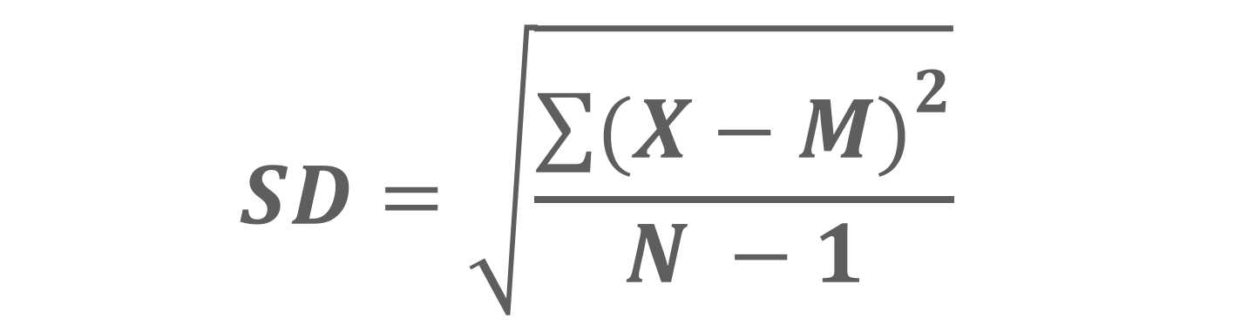
Computing Standard Deviation
Essentially it is the average deviation from the mean (X – M)
$$SD=\sqrt{\frac{{\sum{(X−M)}}^{2}}{N −1}}$$
Notes:
You won’t need to compute this by hand in this class
But I think it is useful to understand what the standard deviation is
Also it is good to know all the pieces
X – M is the deviation from the mean
Bigger deviations from the mean = bigger SD
N is the number of observations so a bigger N can make the SD smaller

Slide 21
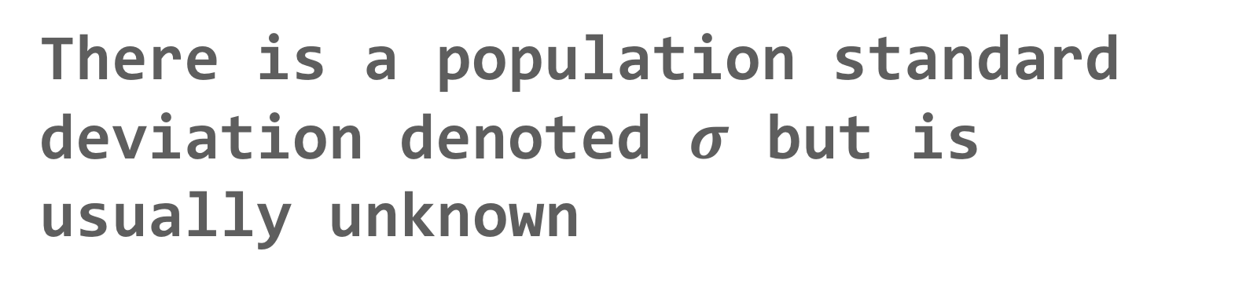
Other Stuff about Standard Deviation
There is a population standard deviation denoted $σ$ but is usually unknown
Our SD is an estimate of the population standard deviation
Notes:
You won’t need to compute this by hand in this class
But I think it is useful to understand what the standard deviation is
Also it is good to know all the pieces
X – M is the deviation from the mean
Bigger deviations from the mean = bigger SD
N is the number of observations so a bigger N can make the SD smaller

Slide 22
Age | Grade
21 | A
25 | B
34 | A
21 | B
22 | C
28 | B
33 | B
29 | A
Variability
What is the range of Age?
What is the range of Grade?

Slide 23
Age | Grade
21 | A
25 | B
34 | A
21 | B
22 | C
28 | B
33 | B
29 | A
Variability
What is the range of Age?
Range = 34 – 21 = 13
= 21 to 34
What is the range of Grade?
Range = A to C

Slide 24
Confidence Interval
An interval that helps us understand the uncertainty in an estimate
We don’t know this
Average Hours of Netflix per night
True
Population
Value
-3
0
3

Slide 25
Confidence Interval
An interval that helps us understand the uncertainty in an estimate
Let’s say our sample’s mean was here
-3
0
3

Slide 26

Confidence Interval
An interval that helps us understand the uncertainty in an estimate
This interval shows our uncertainty in our estimate of the mean
-3
0
3
95% Confidence Interval will contain the true population parameter 95% of the time

Slide 27
Confidence Interval
An interval that helps us understand the uncertainty in an estimate
This interval shows our uncertainty in our estimate of the mean
-3
0
.75
2.0
3
“We are 95% confident that the true population mean is between .75 and 2.0.”

Slide 28

Confidence Interval
An interval that helps us understand the uncertainty in an estimate
This interval shows our uncertainty in our estimate of the mean
-3
0
.75
2.0
3
$$Interval=Estimate±Uncertainty$$
Bigger SD,
bigger interval
Depends on the SD and the confidence level

Slide 29
Confidence Interval
An interval that helps us understand the uncertainty in an estimate
We will use this throughout the semester, not just with means but with other estimates too
Basically always have the same interpretation

Slide 30
Questions?
Please post them to the discussion board before class starts
End of Pre-Recorded Lecture Slides

Slide 31
In-class discussion
slides

Slide 32
Quick, Quiet, Qualifying Quiz

Slide 33
Review
The figure to the right is reliable/unreliable and valid/invalid.
When should you use the mean? What about the median?
What does the standard deviation tell us?
Can we obtain a standard deviation with nominal data?

Slide 34
Reading
What is the difference between a sample and a population?
What are descriptive statistics?
True or False. Inferential statistics help us use our sample to understand the population.
True or False. Independent Variables are also known as outcomes.
Hypothesis tests inform us about the ___________ of our findings.

Slide 35
Reading
True or False. Hypothesis testing informs us about the population.
Is a nominal variable more qualitative or quantitative?
What information does a bar chart provide? What about a histogram?
What is an estimate?
What does a confidence interval tell us?

Slide 36
Application
Example Using the Class Data &
The Office/Parks and Rec Data Set
Visualizations and Descriptives
in Jamovi

